Slide 1
Key Insights procured over Analysis
Direct Marketing campaign of a European Banking institution
Submitted by
S Teja
Gramener Analytics
11- 09- 2016

Slide 2
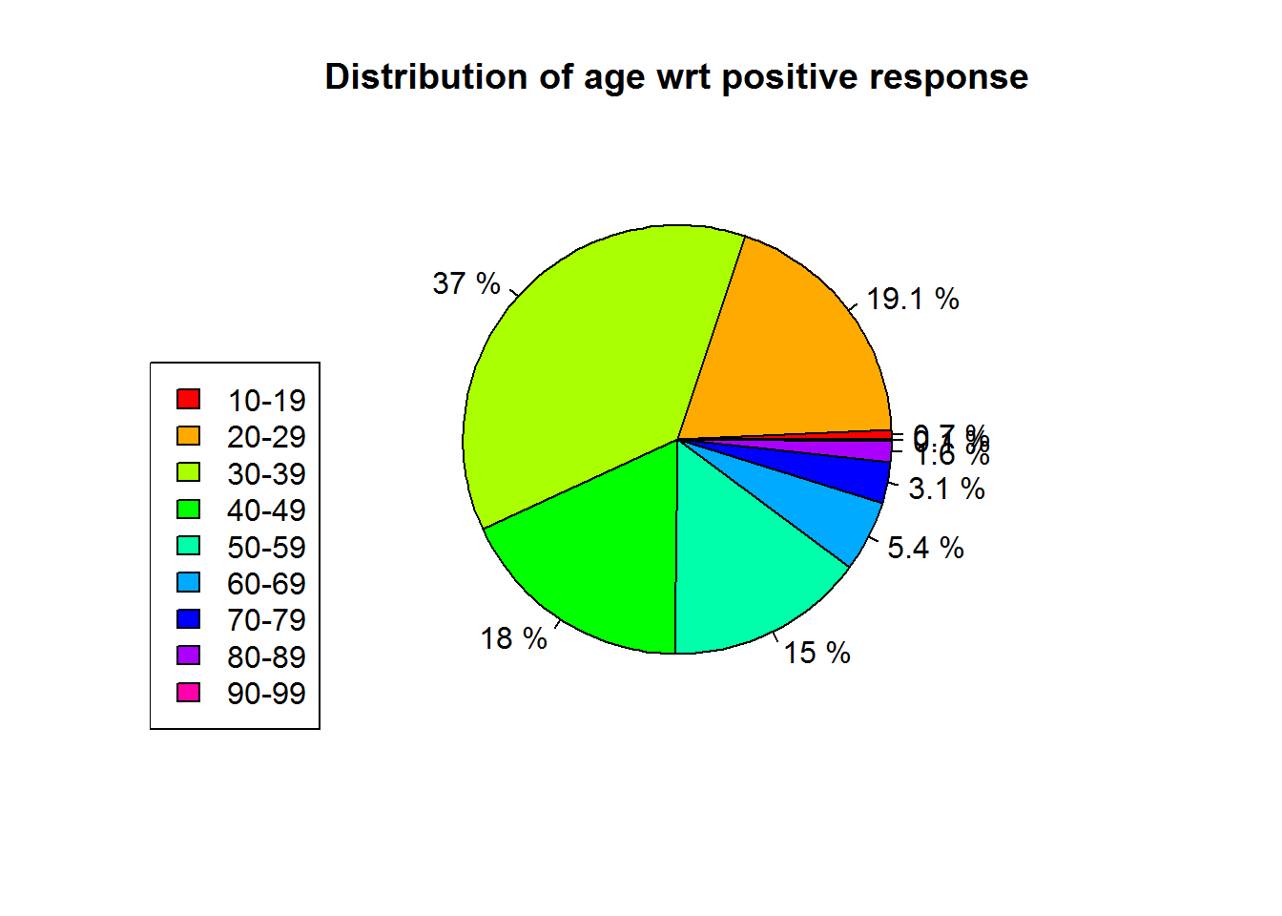
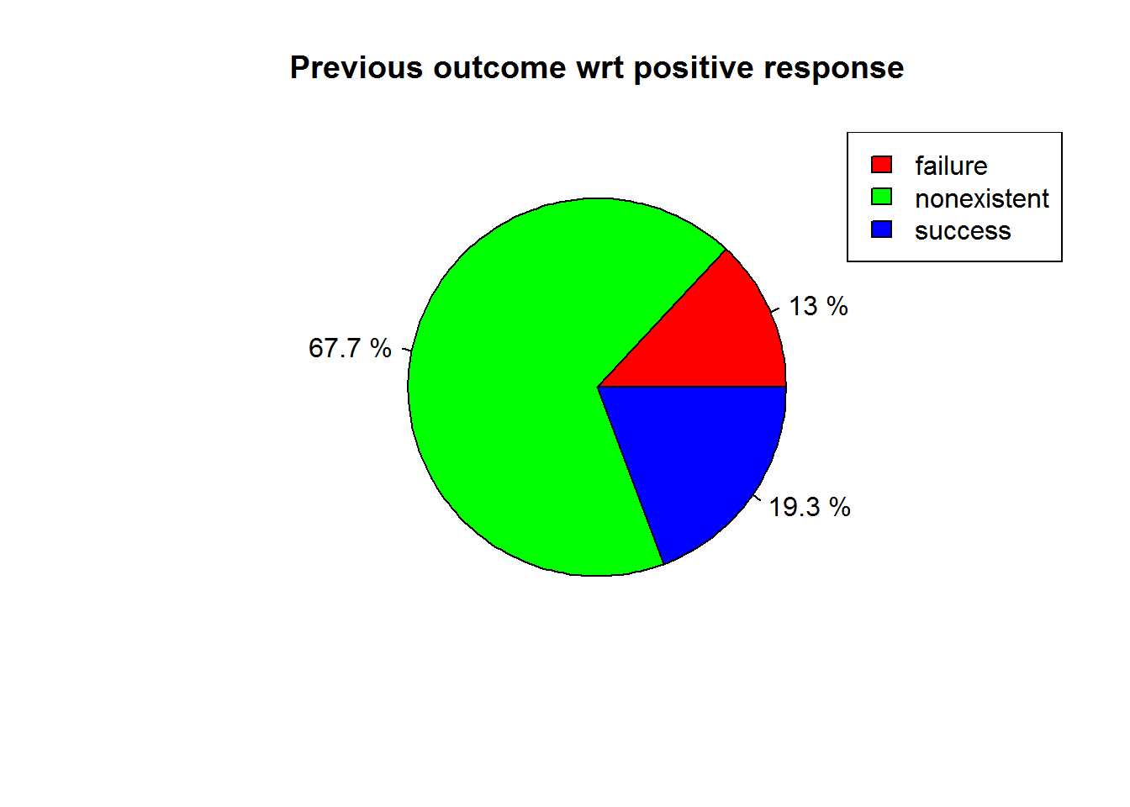
Summary
Plot to show the distribution of Age and count of clients w.r.t. the positive response on the campaign
Success rate of the Term deposit campaign w.r.t. the outcome of the previous campaign.

Slide 3
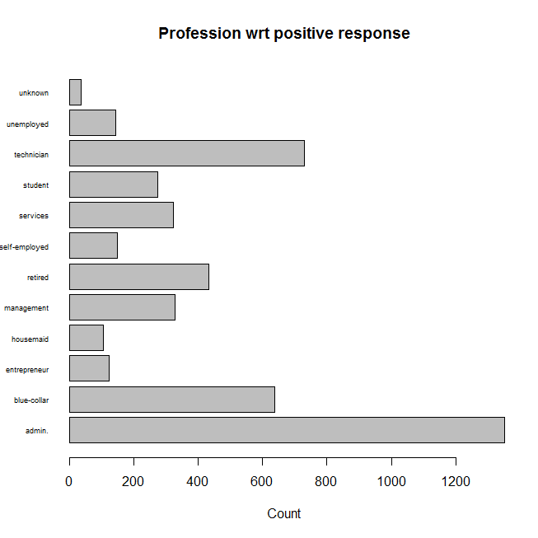
Variation of positive response w.r.t the count of the profession of the term subscribers.

Slide 4
A small analysis has been carried out to map out the clients who doesn’t have a housing loan, credit default or any other personal loan, has been contacted for the campaign.
And are mapped out to their respective responses on the campaign.
 | New.User_Response | Count
1 | no | 26574
2 | yes | 14614

Slide 5
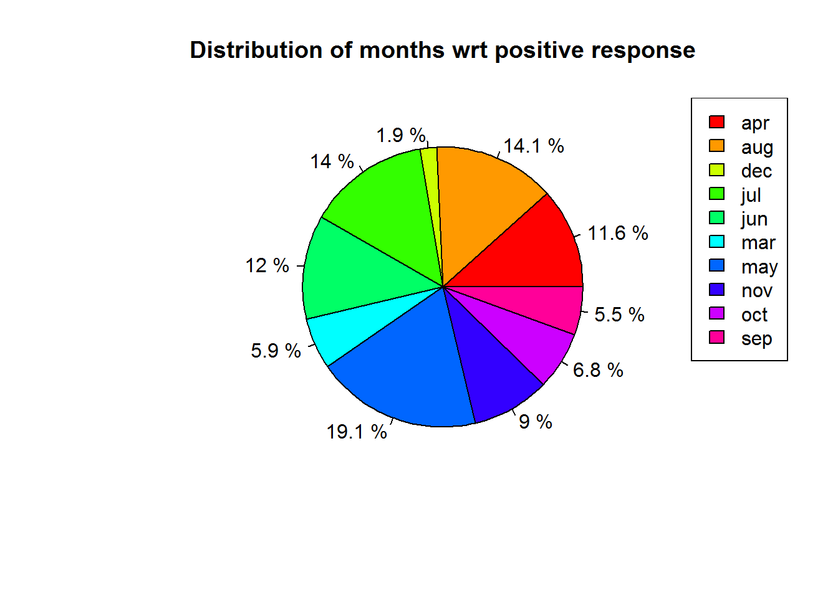
Variation of monthly subscriptions with positive response on the campaign.

Slide 6
Thank you

